Slide 1
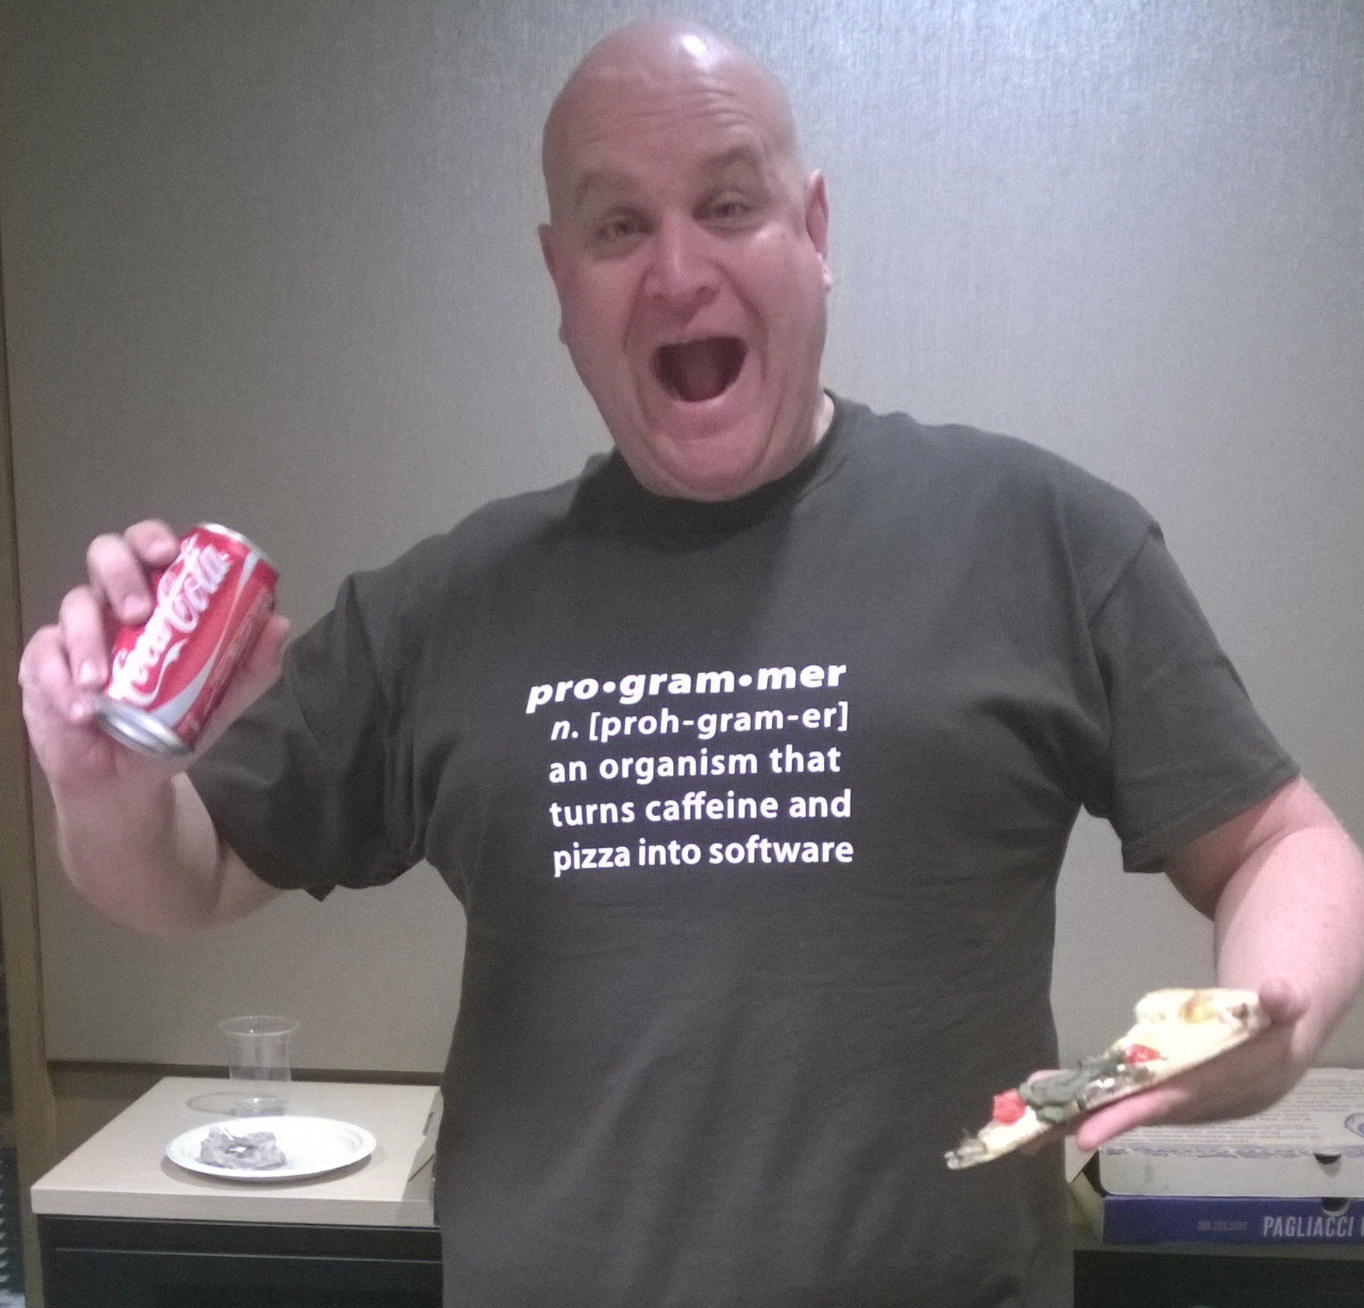

DocumentDB Azure Conf 2015
Ryan CrawCour Program Manager, Microsoft @ryancrawcour | David Makogon Cloud Architect, Microsoft @dmakogon

Slide 2
Today’s talk
What is DocumentDB? (5-minute lightning-round edition)
Meet today’s data: Movies
Queries and indexing: Demos with a side of Q&A
Amazing #AzureConf tweets!

Slide 3
<add docdb slide>
Show where docdb fits in the Azure data landscape (borrow from old docdb deck from last year)

Slide 4
Azure DocumentDB: Lightning Round Edition
{
name:"Azure DocumentDB",
classification: "NoSQL",
dbType: "Document",
connectVia: [ "rest", "sdk" ],
manageVia: [ "portal", "rest", "cli", "sdk" ],
differsVia: [ "service", "js", "indexing", "consistency"
]
}
Notes:
Jump to portal to show features

Slide 5




DocumentDB Resource Model
Account
Databases
Collections
Documents
Attachments
1010100100
Users
Stored Procedures
JS
Permissions
Triggers
JS
User Defined Functions
JS
Notes:
SQL syntax – familiarity with traditional
- automatically indexed
- flexible schemas
Multi-document transactions
- stored procedures/triggers is transactional
Tunable and fast – consistency levels
- strong
- bounded staleness
- session
- eventual
- indexing
-consistent
-lazy
Highly scalable – customers with terabytes
- fully managed
- quick startup

Slide 6
Service consumption
{
units:"RequestUnit",
tiers: [250, 1000, 2500],
behavior: [ "consistent", "predictable" ],
measured: "per operation",
reportedVia: "response header",
granularity: "hour",
}
Notes:
Normalized measurement model for multitenant db.
Similar to SQL Database DTU's

Slide 7
Out-of-the-box indexing
{
"id" : "123",
"age" : 30, "name" : "joe",
"address" : {
"street" : "some st",
"city" : "San Jose"
}
}
/id /age
/name /address /address/street
/address/city
Range index
Hash index

Slide 8
Demos

Slide 9
Example movie JSON
{
"id": "movie203801",
"title": "The Man from U.N.C.L.E.",
"tagline": "A Higher Class of Hero.",
"genres": [
{ "id": 35, "name": "Comedy" },
{ "id": 28, "name": "Action" },
{ "id": 12, "name": "Adventure" } ],
"overview": "In the early 1960s, ...",
"release_date": "2015-08-14",
"runtime": 116,
"vote_average": 3.5,
"type": "movie"
}

Slide 10
Demo recap

Slide 11
Default indexing
SELECT * FROM movies m
WHERE m.title = "Ant-Man"
SELECT * FROM movies m WHERE m.vote_average >= 3 AND m.vote_average <= 4
Equality on strings
Range on numbers
Notes:
<querymovie.js>
This demo is done in the portal, then in the shell

Slide 12
Arrays
SELECT m.title, m.overview
FROM movies m
JOIN g IN m.genres
WHERE g.name="Comedy"
Notes:
Querygenre.js

Slide 13
Ranges on strings?
SELECT *
FROM Movies m
WHERE m.title BETWEEN "A" AND "B"
Notes:
Run addrangeindexes.js. After, run resetindexes.js
Catch exception
Edit to force scan. Show cost
Run addrangeindexes.js, re-show.

Slide 14
Exclude paths from index
SELECT *
FROM Movies m
WHERE m.overview = 'Documentary'
Notes:
Excludepath '/overview/*' then run resetindex
Need to fetch one, see its id
Remove path, re-query, see it fails. Query on a still-indexed property (like id or title)

Slide 15
Geospatial
SELECT * FROM cinemas c WHERE ST_DISTANCE(c.location, {
"type": "Point",
"coordinates": [-121.889125, 37.33034]
}) < 5 * 1600
SELECT * FROM cinemas c WHERE ST_WITHIN(c.location, {
"type": "Polygon",
"coordinates": [[ [-124.63, 48.36], [-123.87, 46.14], [-122.23, 45.54], [-119.17, 45.95], [-116.92, 45.96], [-116.99, 49.00],
[-123.05, 49.02], [-123.15, 48.31],
[-124.63, 48.36]
]]})
Notes:
TBD. Portal-only

Slide 16
Summary
{
default: [
"every path",
"hash on number",
"range on string"
],
indexKind : ["Hash", "Range", "Geospatial"],
paths: ["Include", "Exclude"],
mode: [ "Consistent", "Lazy"],
automatic: [ true, false ],
indexTransforms: ["on demand", "online"]
}

Slide 17




SDKs and Tooling
SDKs
Azure Portal
Studio
aka.ms/docdbsdks
portal.azure.com
aka.ms/docdbstudio
Notes:
DocumentDB offers SDKs and tooling to help you develop against and manage data in the service.
All APIs are accessible as REST over HTTP, we also provide .Net, Node, Java and Python SDKs
I already shown provisioning through the portal – the Azure Preview portal offers a variety of development, monitoring and management capabilities.
DocumentDB Studio is an open source app that allows you to manage and interact with the service from a GUI tool
The Data Migration tool allows you import existing data into DocumentDB

Slide 18






Get Started Today
select * from playground p where p.name = "DocumentDB"
explore playground
build an app
move some data
aka.ms/docdbplayground
aka.ms/docdbstarter
aka.ms/docdbimport

Slide 19
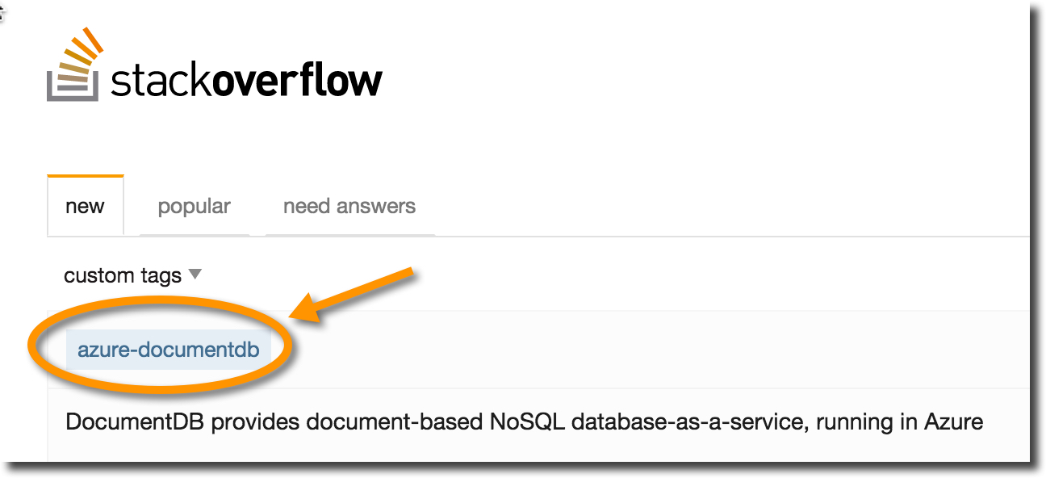
Wrapping up
documentdb.com
@DocumentDB
@dmakogon
@ryancrawcour
github.com/azure/azure-documentdb-node
github.com/dmakogon/nosqlnow2015

